Slide 1

Renforcer la surveillance des maladies infectieuses à travers les standards de données et d'interopérabilité
Utilisation de la méthodologie WHO SMART guidelines
Dr Patricia Ndumbi
Department of Surveillance Systems
WHO Health Emergencies Programme
Notes:
Epidemiologiste dans le department des Systemes de Surveillance a OMS geneve

Slide 2

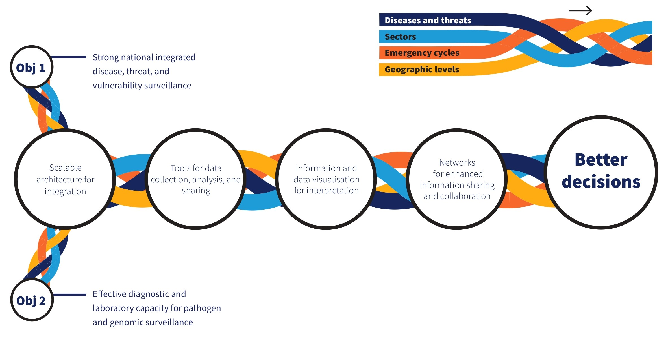
Surveillance collaborative : une vision moderne de l'intégration et de la collaboration en matière de surveillance des maladies
Capabilities for facilitating collaborative approaches for event detection, risk assessment and response monitoring
Notes:
La pandemie du covid a mis l’emphase sur le besoin de renforcer la partage des donnée et la coordination des response sanitaires au niveau global
C’est pour ca que l’OMS a lancé il y’a un an sa nouvelle strategie de surveillance collaborative qui definie les capcités requise pour que les pays puissant mieux repondres aux epidemies
Un des obj. de cette strategie c’est d’aider les pays a developer des systems de surveillance integrés
Cependant ceci requiert que ces systeme puissant communiquer entre eux, ce qui n’est pas toujours le cas

Slide 3
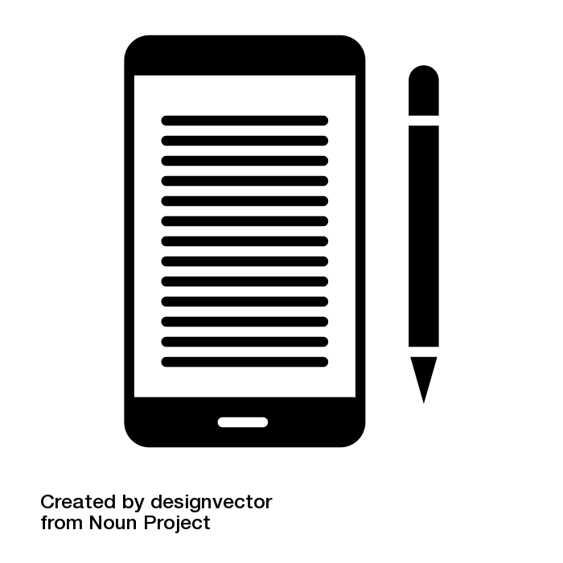













Multiples systèmes, nombreuses intégrations, fardeau de maintenance, coûts élevés
Data Collection
Data Warehouse
Data Visualization​
Vaccination
X-MART
CB Surveillance
Contact tracing
Lab
PoE
Lack of standardized terminologies and interoperability standards
Notes:
Further to these issues….
Pendant plusieures decennies les systems de surveillances etaient principalement base sur la collecte de donnée sur papiers
L’introduction des systems electronique a maqrqué un changement dans la collecte des données, particulierement aux niveaux des zones de santé et nationnaux
Mais cette proliferation de systèmes digiteaux, qui ne communiquent pas entre eux, cree aussi bcp de probleme d’integration
(Next click) gerables avec 2 ou 3 systems
(Next click) mais pas viable/durable au long terme avec plusieures systems
Problemes principalement causes par un manque de standards de terminologie et d’interoperabilités

Slide 4
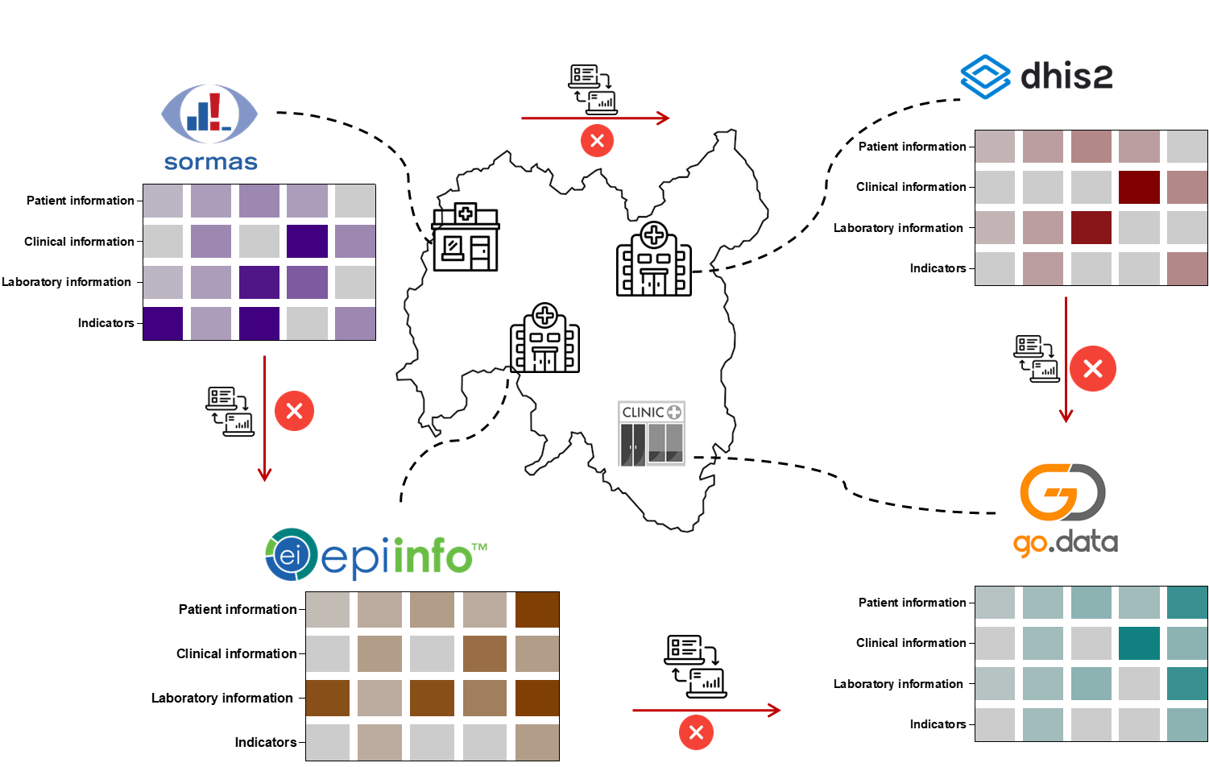
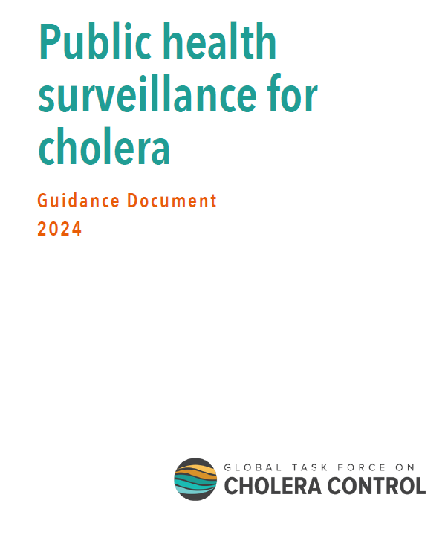
Contexte actuel : L'absence d'adoption des standards de données de surveillance produit la fragmentation des systèmes de santé numérique.
Minimum core data elements & indicators recommended by WHO
Notes:
Par consequent, le context actuel est maqrqué par la fragmentation des systems electroniques
L’OMS emmet ces recommendations mais elles sont adoptees differement dans les systems.
Clinique → Hopital → Lab …. Systemes non harmonisés qui requiert la saisie répétée des données d’un système a l’autre
ceci generent des silos d’information
Qui nous empechent d’avoir une comprehension complete de la situation epidemique

Slide 5
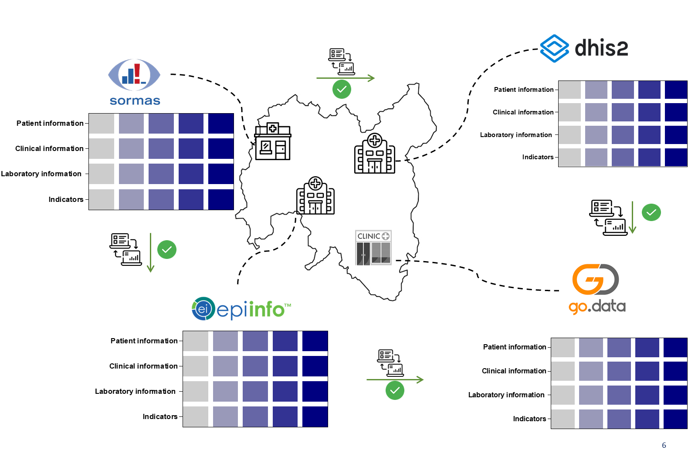
Context futur : L’adoption des normes de données de surveillance produit des systèmes de santé numérique cohérent.
Minimum core data elements & indicators recommended by WHO
Notes:
Context future envisagé
Harmonization des standard des données qui permet l’integration et l’interoperabilité des systèmes
Ceci nous permettra de mieux generer des informations a partir des données

Slide 6
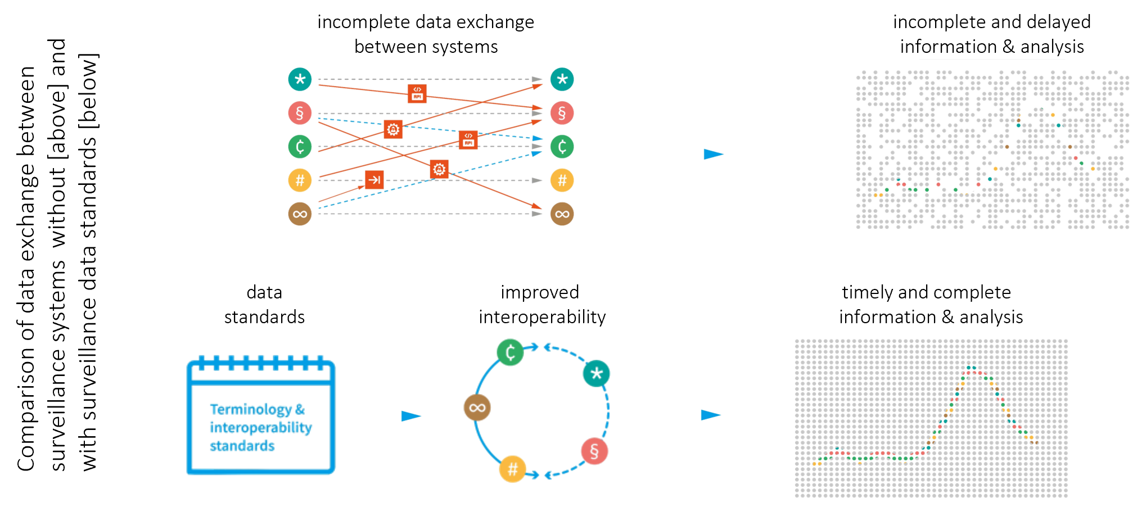

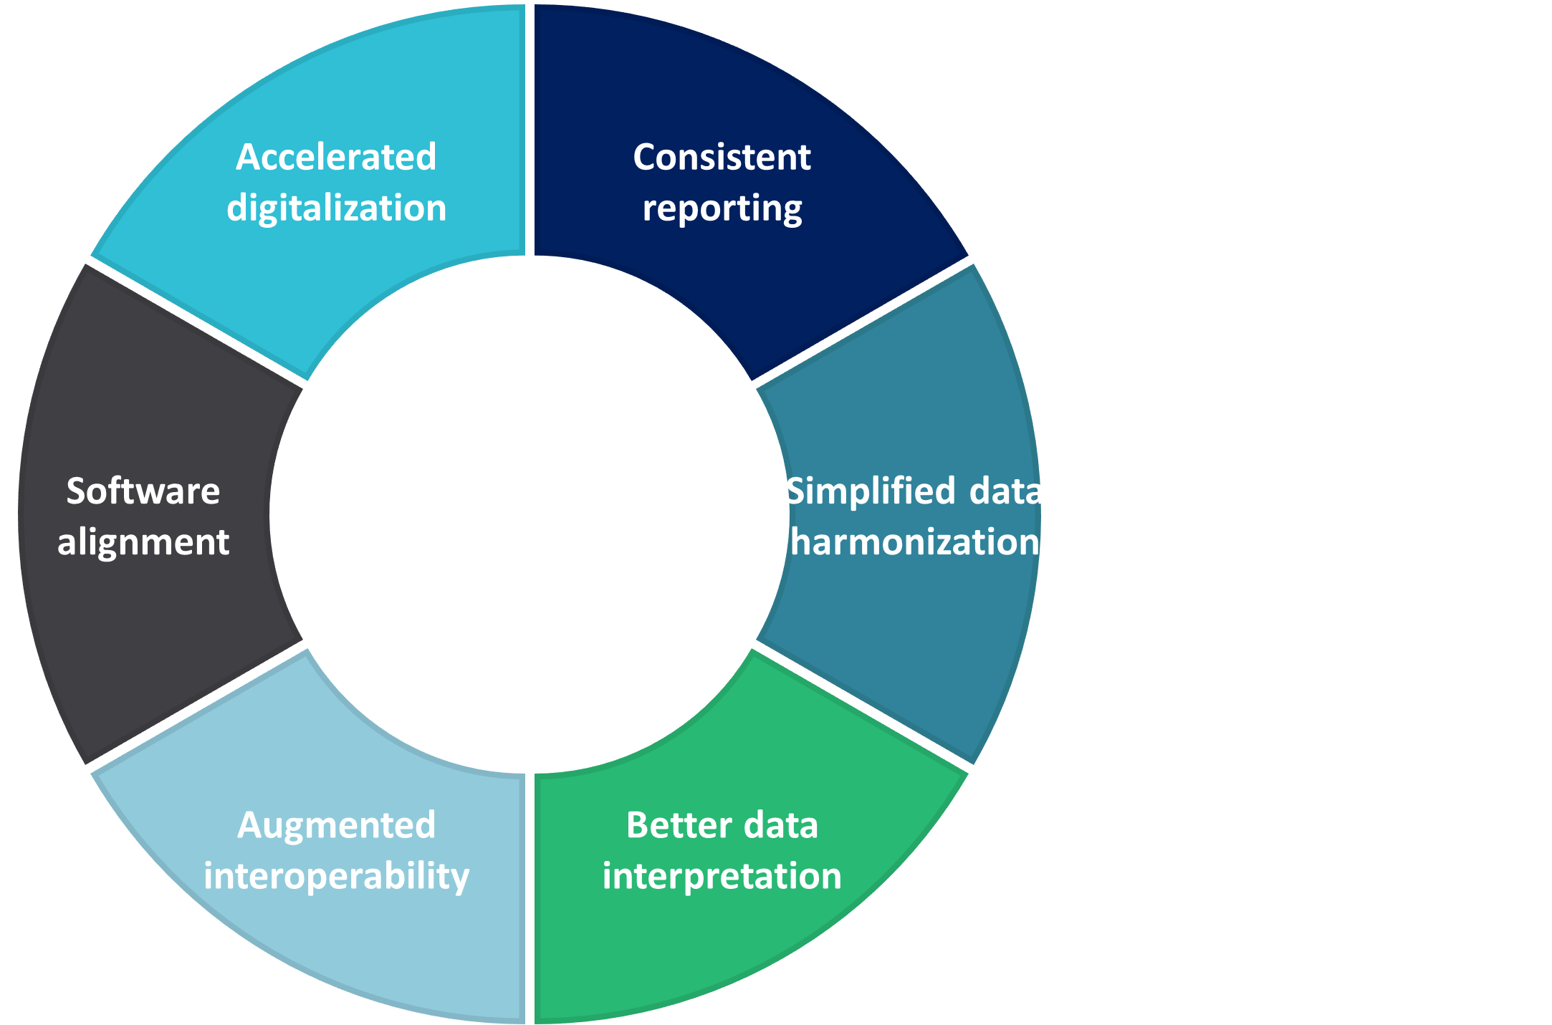

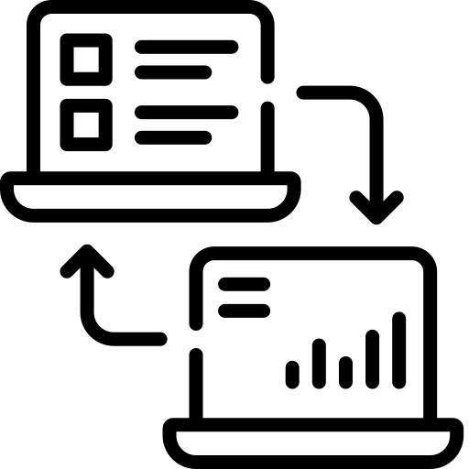
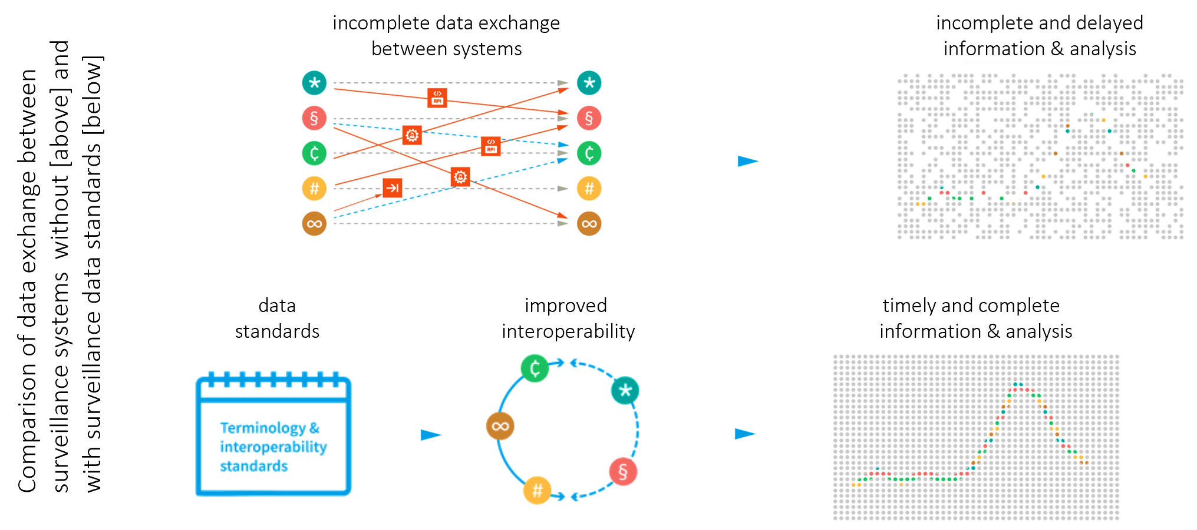
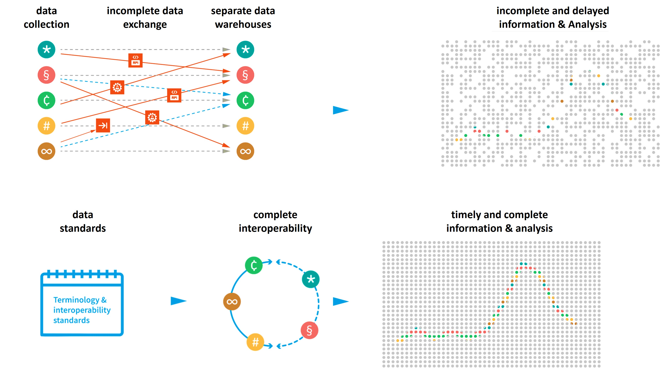
Standardisation des données de surveillance pour une meilleure intégration des systèmes de données.
6
Context actuel
Approche basée sur les standards
Context Futur
§
§
∞
#
#
∞
∞
§
Standards de Terminologie & Interopérabilité
#
Notes:
- Casser les silos d’informations pour generer des informations completes et rapide qui peuvent informer la responses au epidemie

Slide 7
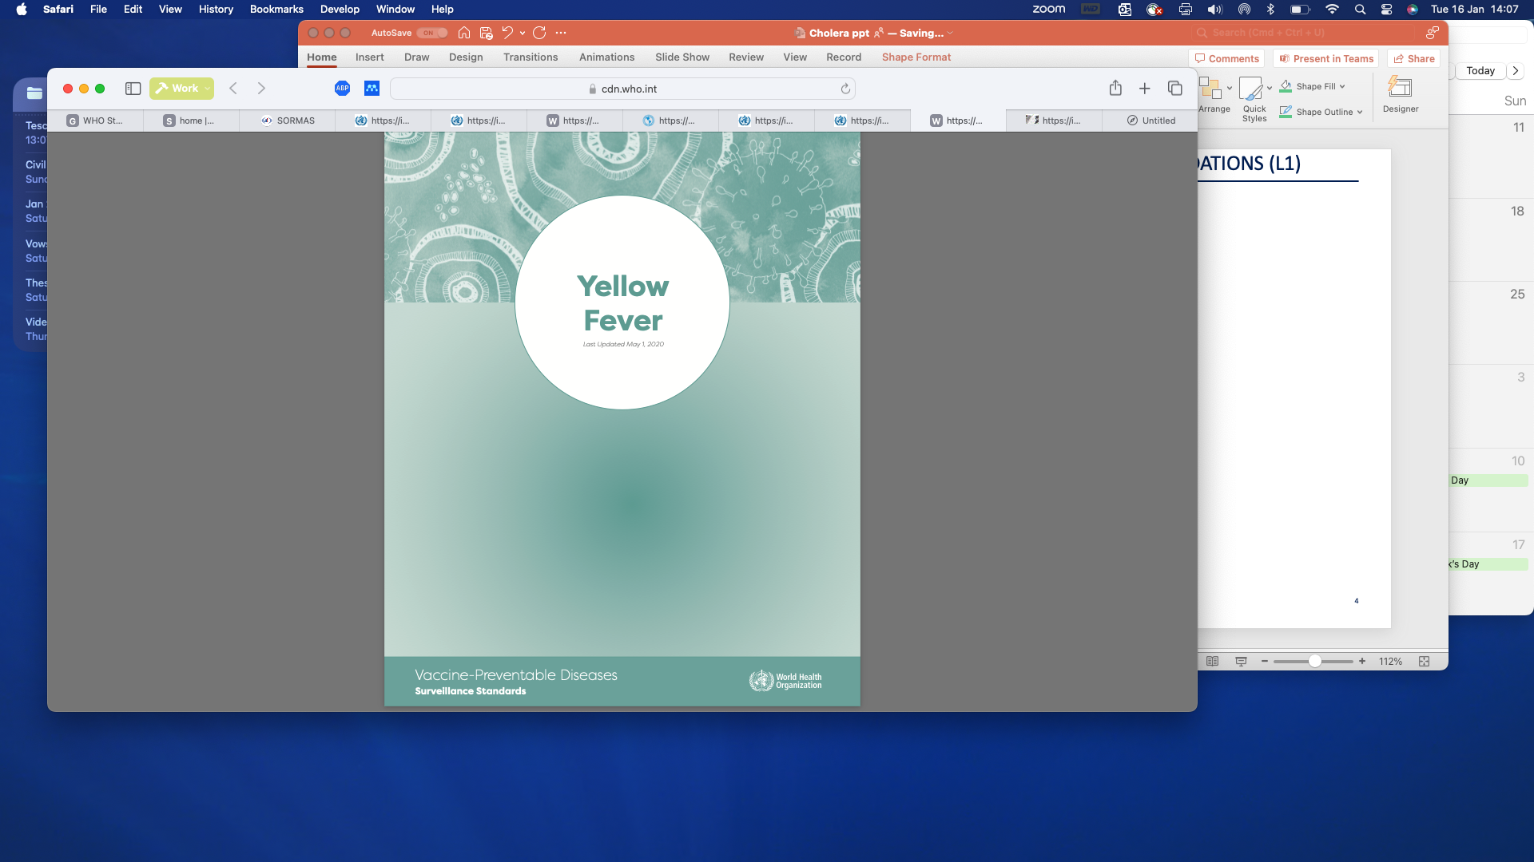
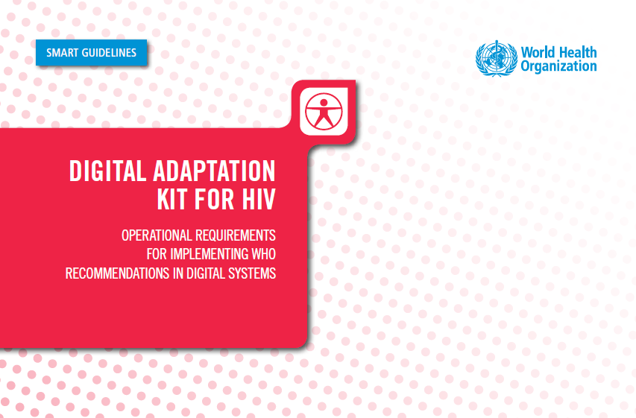
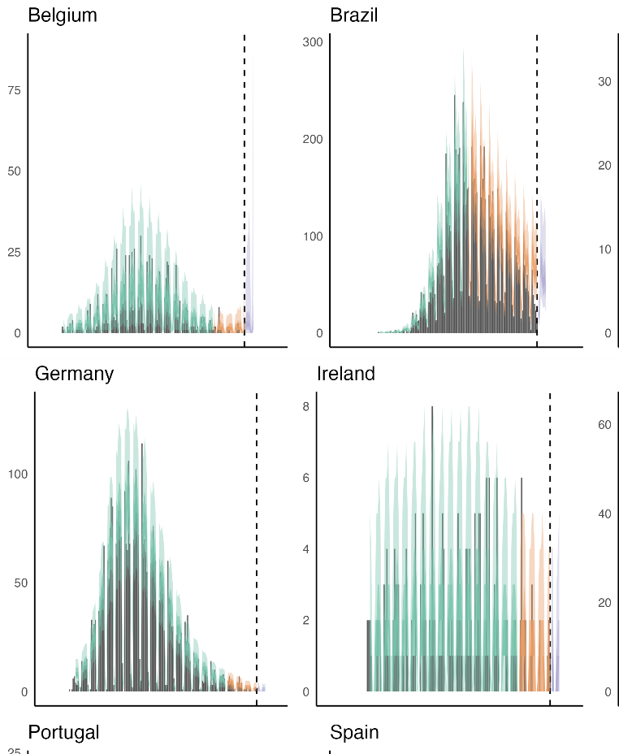
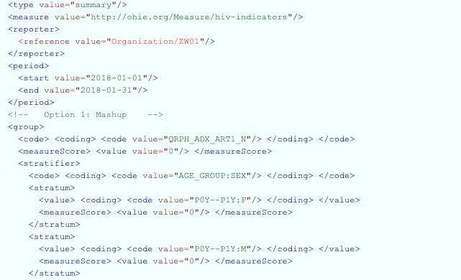

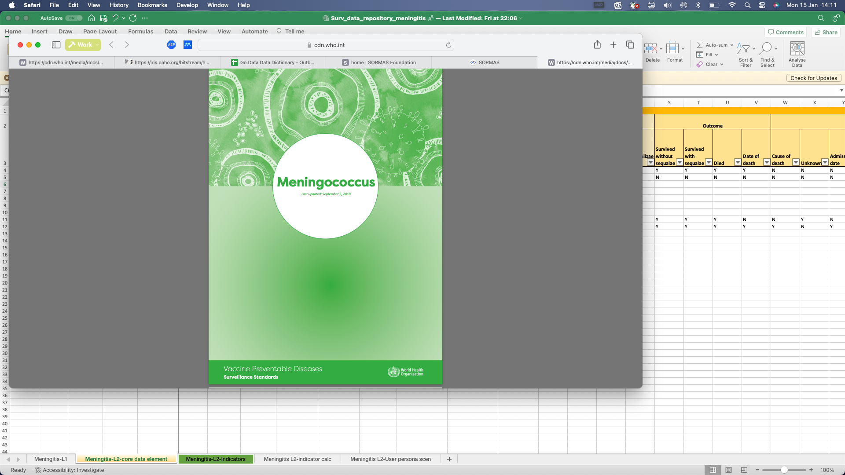
SMART Guidelines – Une approche structurée vers l’interopérabilité
Narrative
Operational
Machine readable
Executable
Dynamic
Global surveillance guidelines
Digital Adaptation Kits for surveillance guidelines
Machine-readable guideline
Digital tools aligned with WHO guidelines
Advanced analytics models
Layer 1
Layer 2
Layer 3
Layer 4
Layer 5
Traditional narrative guidelines (PDF or paper-based)
Translates narrative guidelines into structured components (e.g., data dictionaries) for operationalizing within national digital systems
Transforms structured components into standards-based software code that enables interoperability in a software agnostic way.
Manifests guidelines in software applications that are ready to be deployed in the field
Advanced analytics for precision public health
Notes:
Narrative
Transform L1 en specification techniques qui expliques clairement au pays et aux developers de systems electronique comment configure et mettre en place leur systems
Pour les aligner avec les norms et standards de l’OMS
L3 - code informatique qui permet l’interoperatbilité
L4 – Logiciels standardisés par défaut…
L5 – Analyse avancé et fédérée

Slide 8
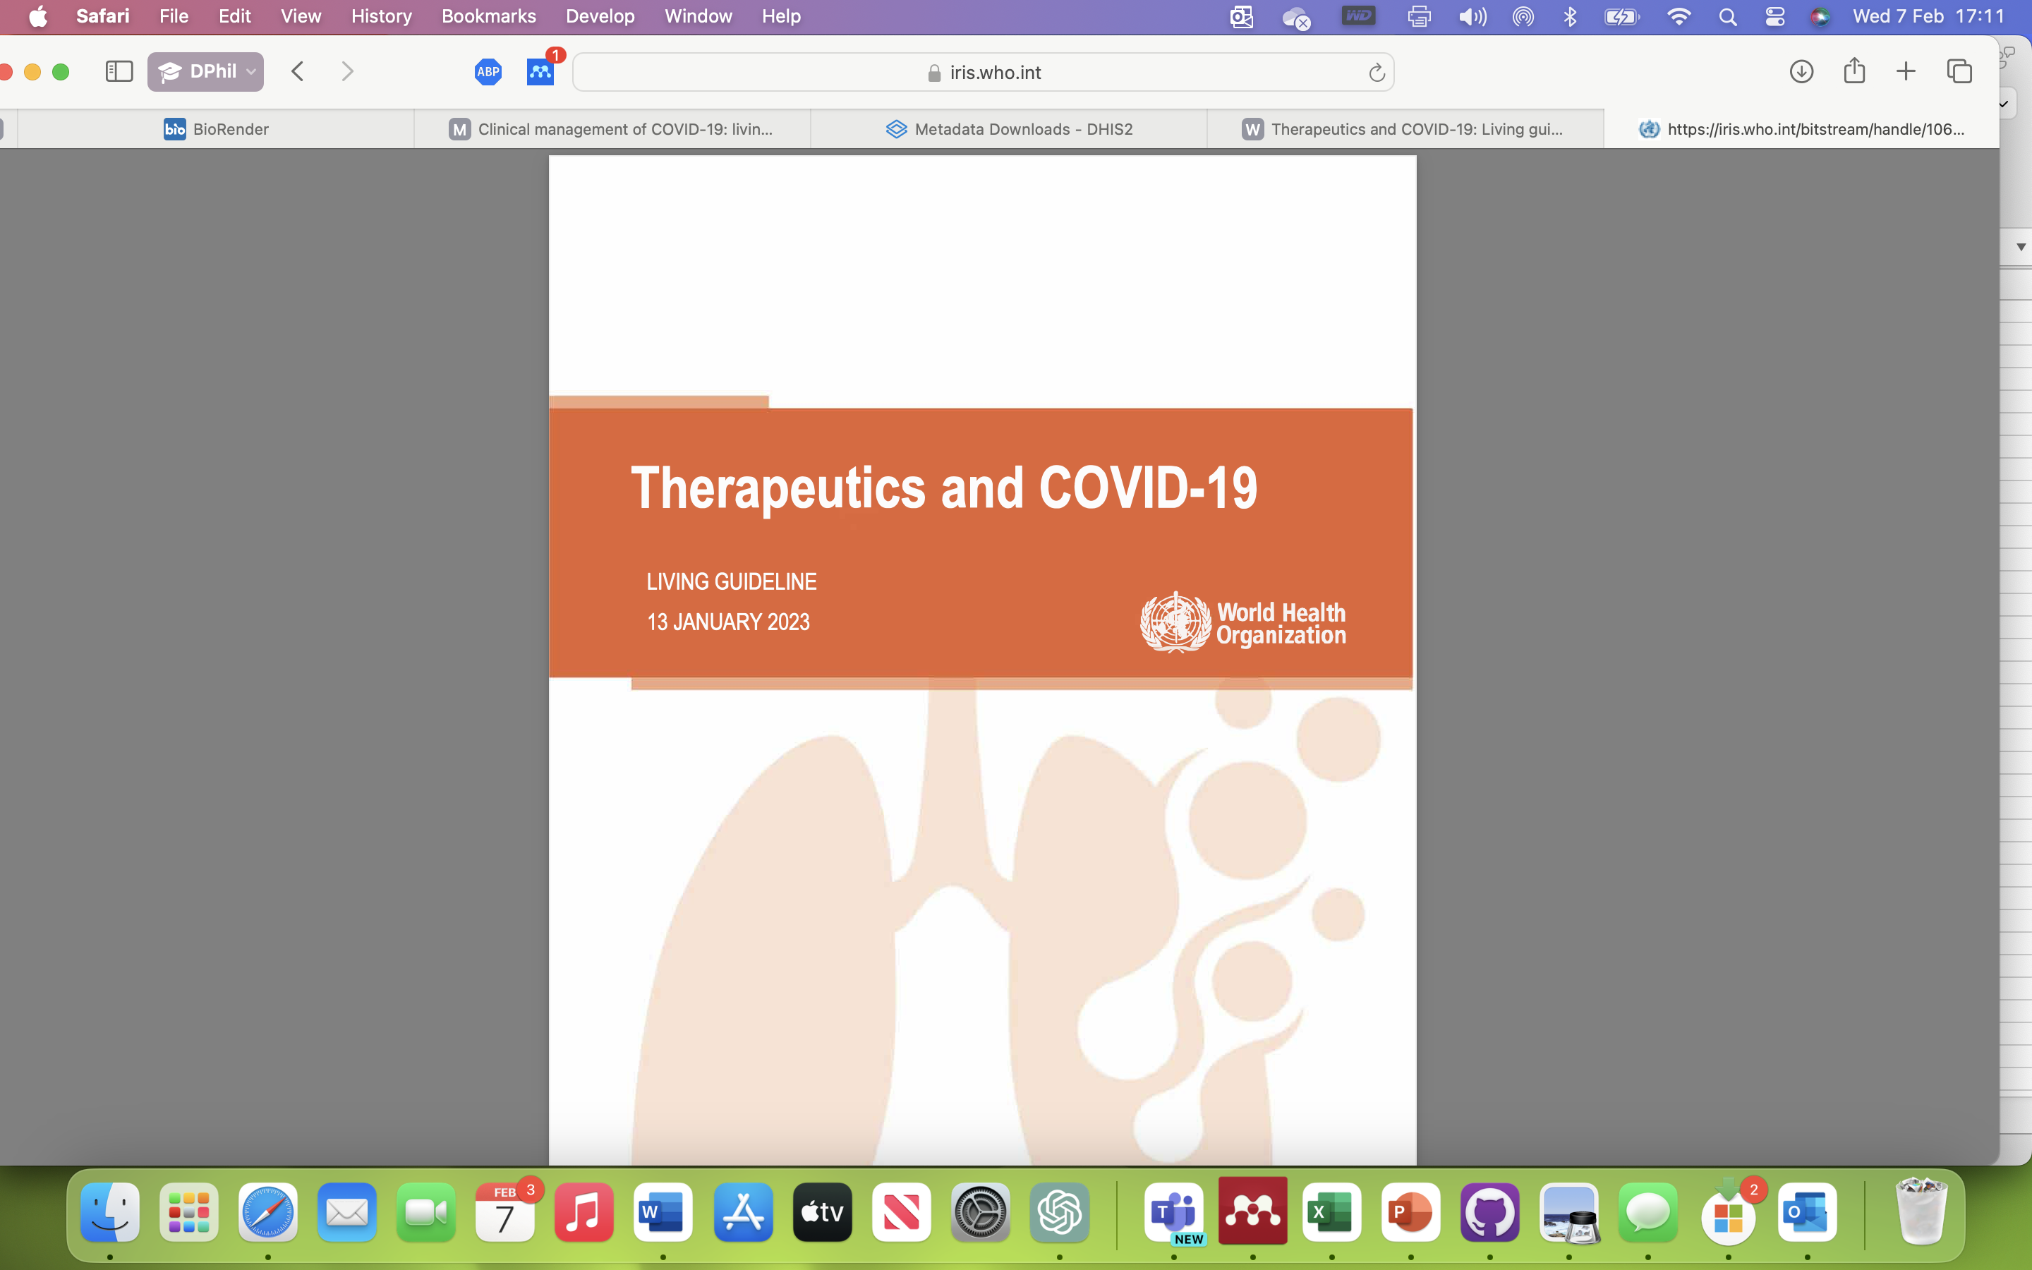
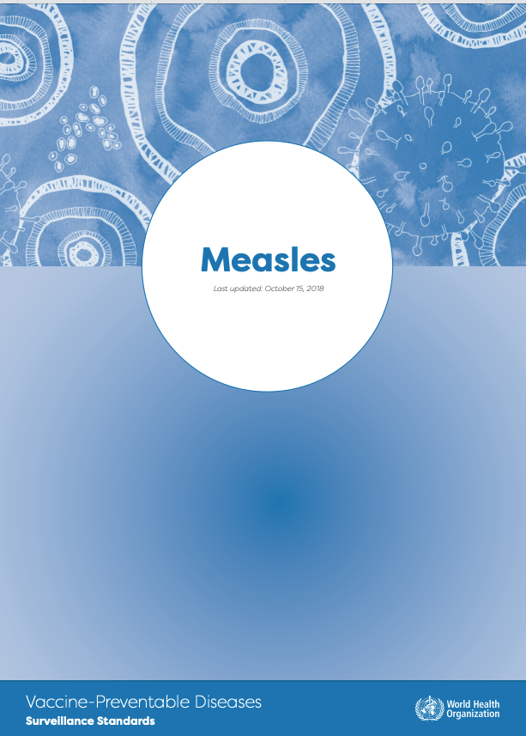
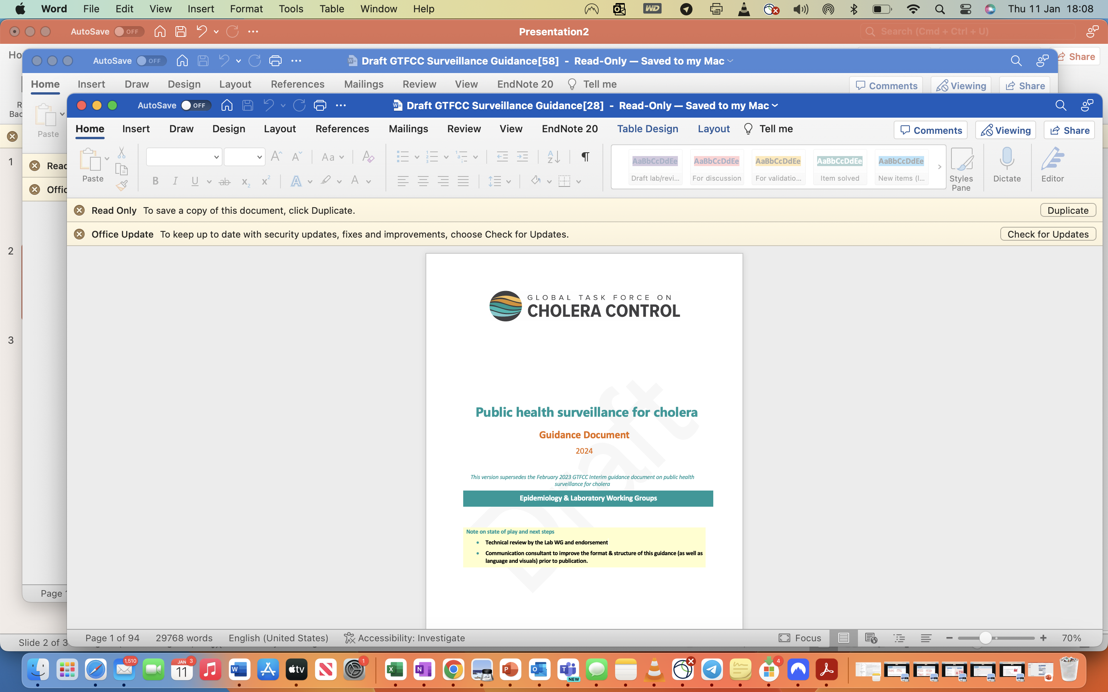
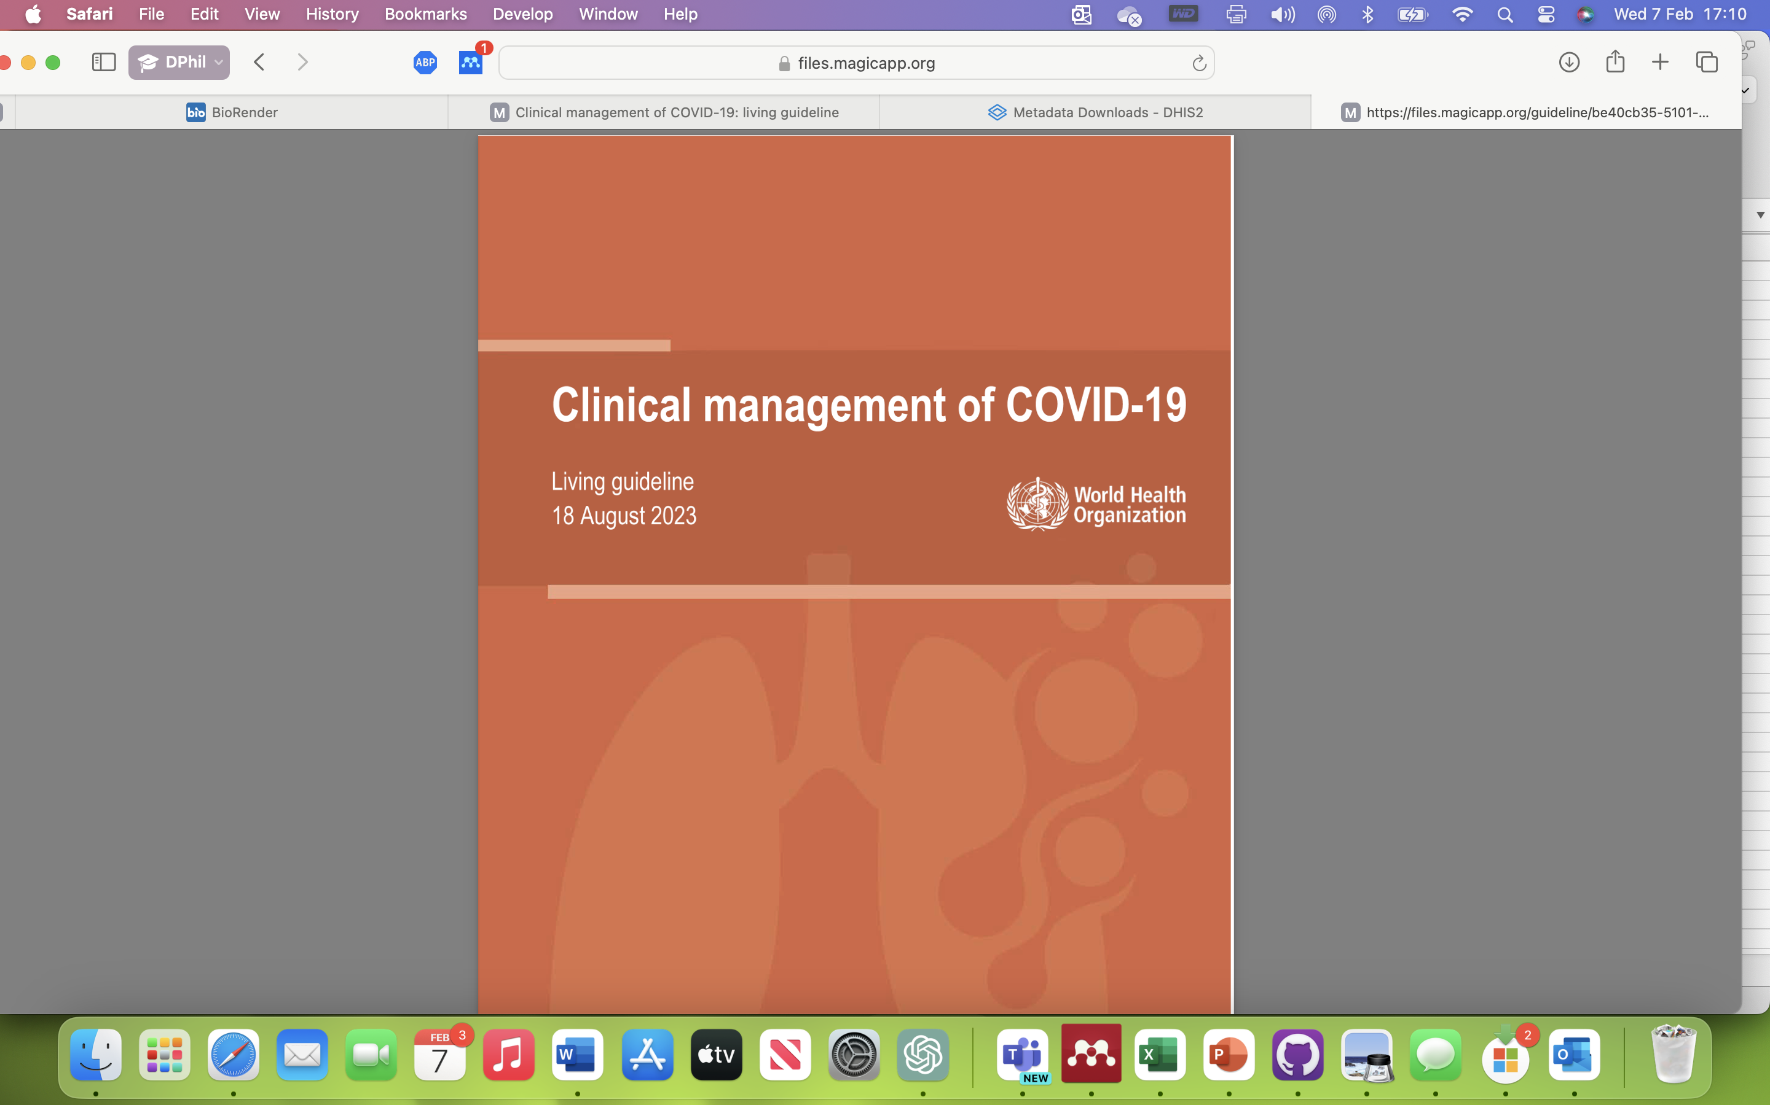
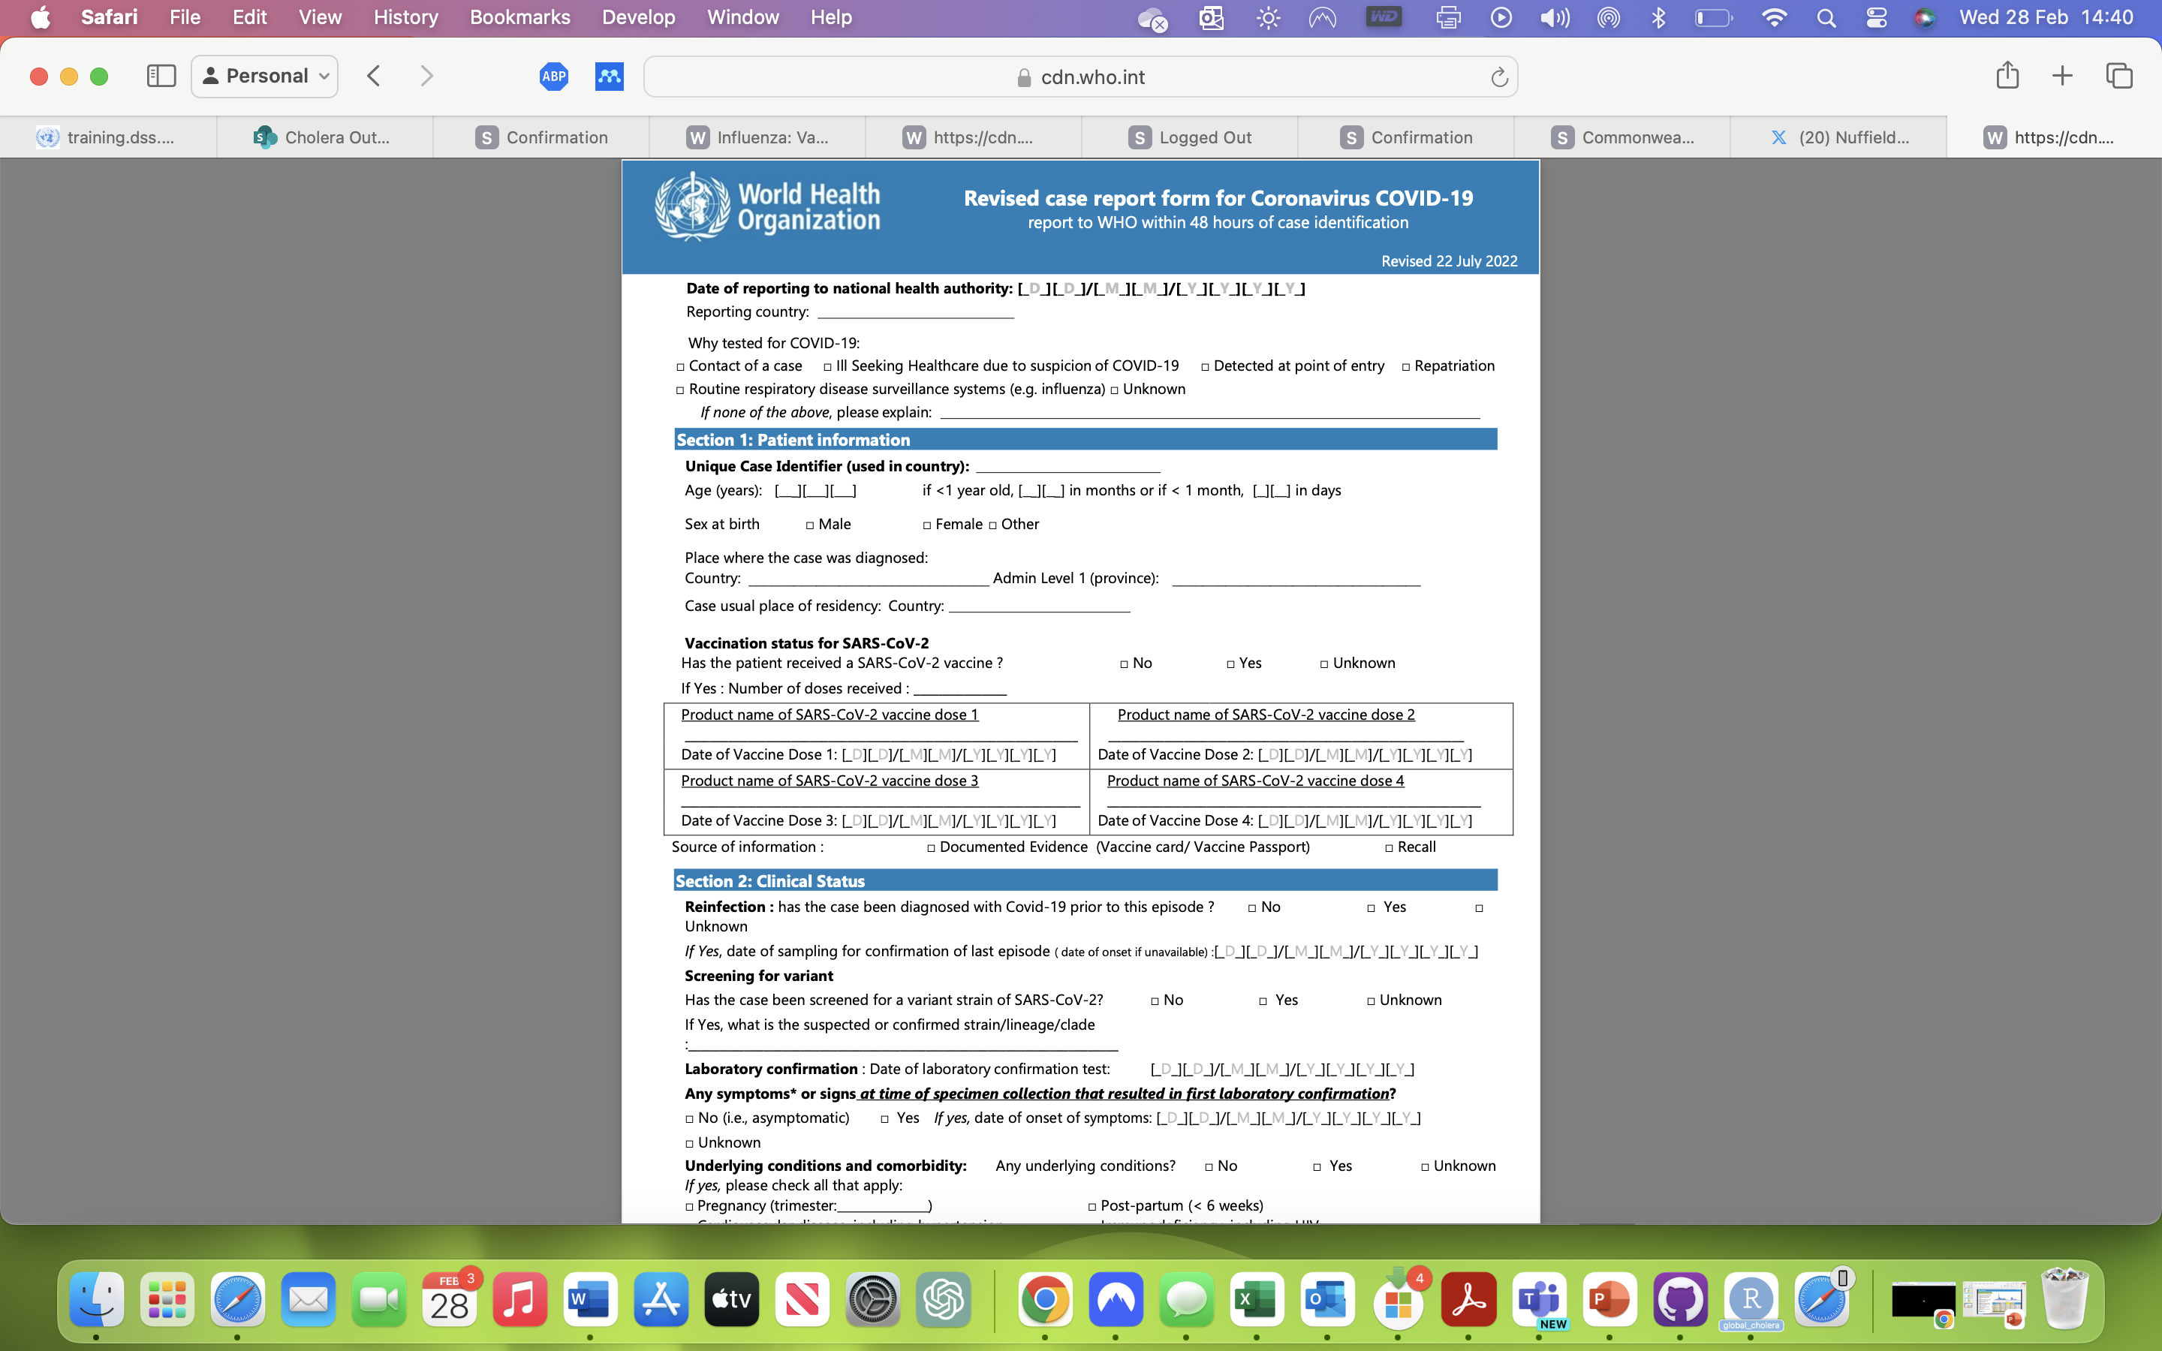


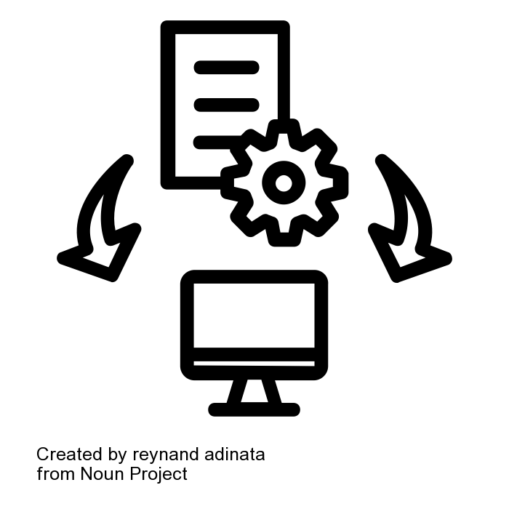
Développement des standards de données: Maladies prioritaires
Disease Prioritization Criteria:
Vaccine preventable diseases
High-impact epidemics
Targeted for elimination or control
Respiratory disease
Measles
Meningitis
Yellow Fever
Cholera
COVID-19
42 Variables
10 Indicators
65 Variables
8 Indicators
22 Variables
9 Indicators
75 Variables
18 Indicators
55 Variables
7 Indicators
Scoping and review of existing guidelines
Commonalities, differences, and gaps within and across guidelines
Representation in widely adopted digital tools
Notes:
Priority diseases
- Also Mpox

Slide 9
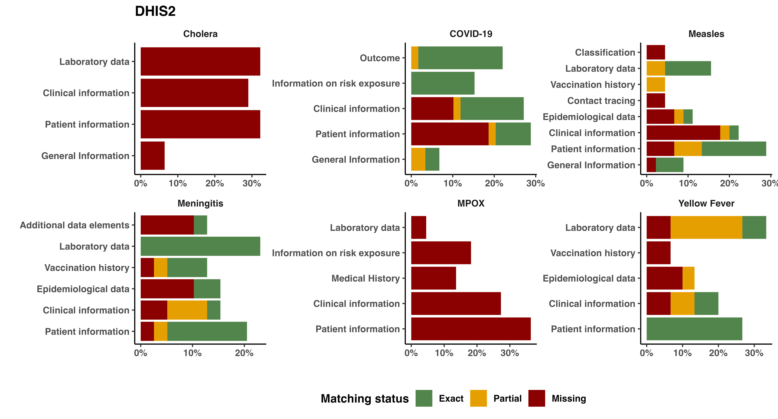
Développement des standards de données: Représentation dans les systems électroniques
Fig: Surveillance and data standard review for five priority diseases in DHIS2
Notes:
Their representation (or lack of) in digital systems
SMART guidelines would support better alignment but also accelerate development of modules that do no exist yet

Slide 10
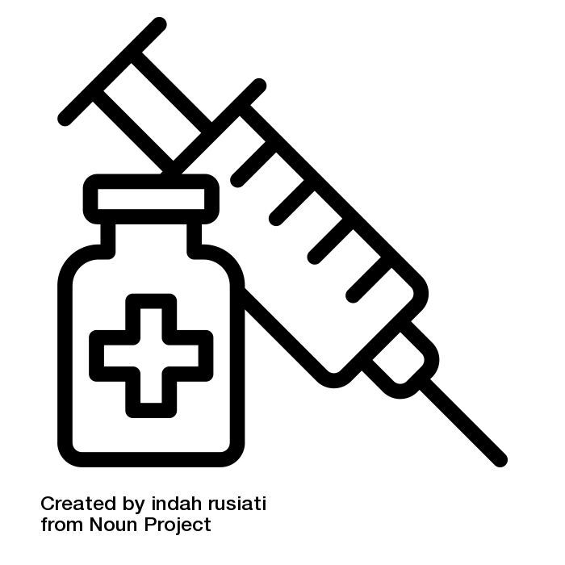

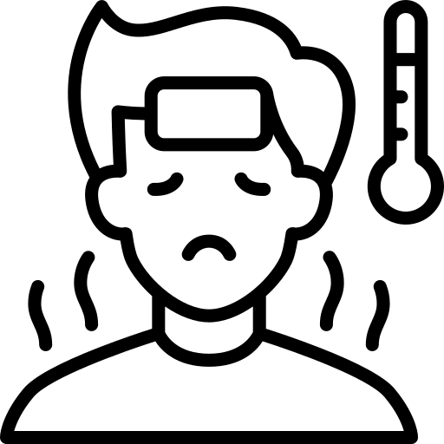
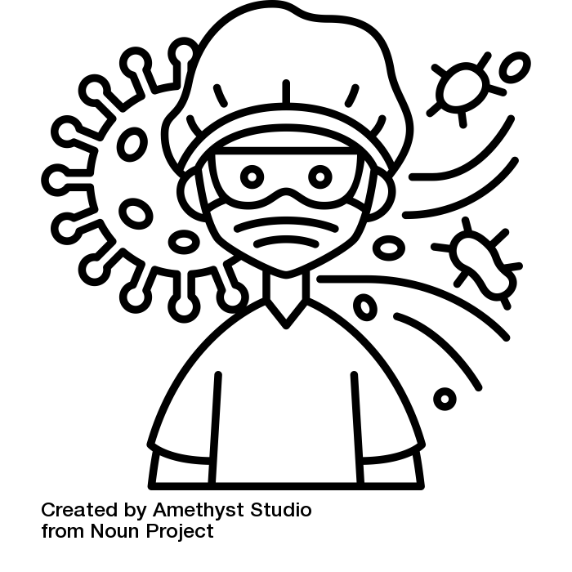






Développement des standards de données: Processus opérationels de surveillance and Points d’integration
Immunization
Immunization registry
Release from pathway/ Referral to other health services
Public Health Surveillance
Registration
Clinical information
Clinical Management
Laboratory
Immunization
Etc.
registration
Registration form
screening
treatment
Clinical management form
Clinical assessment
Laboratory testing
Clinical information form
Laboratory form
Notes:
Finally, we looked at workflows…
A lot of the information we collect for surveillance purposes comes from different systems and activities such as case management, laboratory, immunization, etc..
Therefore, we need to carefully map the touch points with these systems so that the data collected from these can eventually directly flow into the surveillance system and reduce data re-entry issues faced by HCW

Slide 11


Valeur ajoutée et impact sur la santé publique
Surveillance SMART guidelines can:
This will help countries:
Accelerate the transition from paper to digital systems
Strengthen the quality, reporting and use of surveillance data, leading to better informed decision making
Better understand and visualize outbreak dynamics, leading to faster detection and response to outbreaks
Strengthen cross-border coordination through comparable data on health threats.
Reduce cost associated with data integration and software development
Accelerate the adoption and adaptation of WHO surveillance guidelines in digital systems
Make data reporting easier, data harmonization faster, and data use better
Facilitate data exchange and integration through enhanced interoperability

Slide 12
Scénarios d'utilisation pour la mise en œuvre dans les pays
Digital system does not exist or is yet to be identified
Update existing paper registers and decision support
Update content to improve efficiencies of analog processes – reducing data collection
Kick start the requirements gathering process to design the system - reduce time and resources
Digital system established
Update and align within existing systems content to WHO standards and guidance, including interoperability

Slide 13
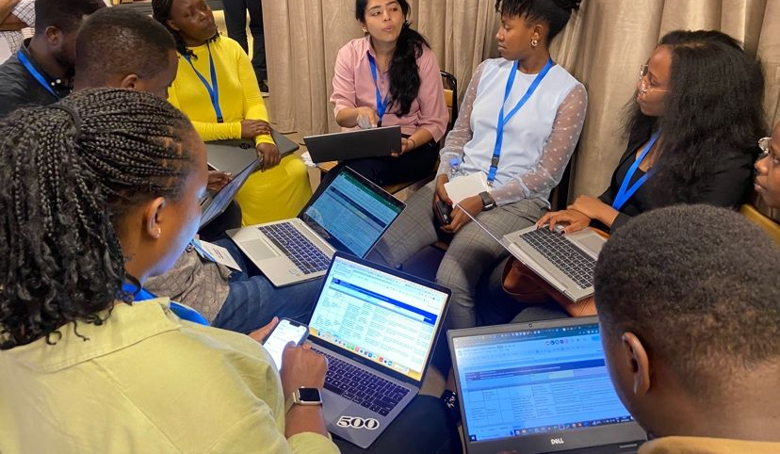
Interoperability hackathon for digital health transformation in the African Region – October 2023
Training and piloting of measles surveillance SMART guidelines in the African Region
Key activities and output
Africa region member states: Kenya, Rwanda, Uganda, Tanzania and Zambia
WS1: Countries adapted DAKs (L2) for measles surveillance and immunization to their national context, and then developed mini-FHIR implementation guides (L3) for those.
WS2: Developers used the mini-FHIR IGs to create demo applications (L4) in just <2 days.
WS3: Countries developed a roadmap to strengthen their digital health architecture to create an enabling environment for SMART guidelines implementation.
All: Capacity building and creation of a community of practice around SMART guidelines development and implementation.
Notes:
Adaptation des smart guidelines au context nationnaux
Developpement de logiciel en ligne avec les smart guidelines
Renforcer l’architecture digital afin de mettre en place un environment qui facilite la mise en oeuvre des smart guidelines

Slide 14
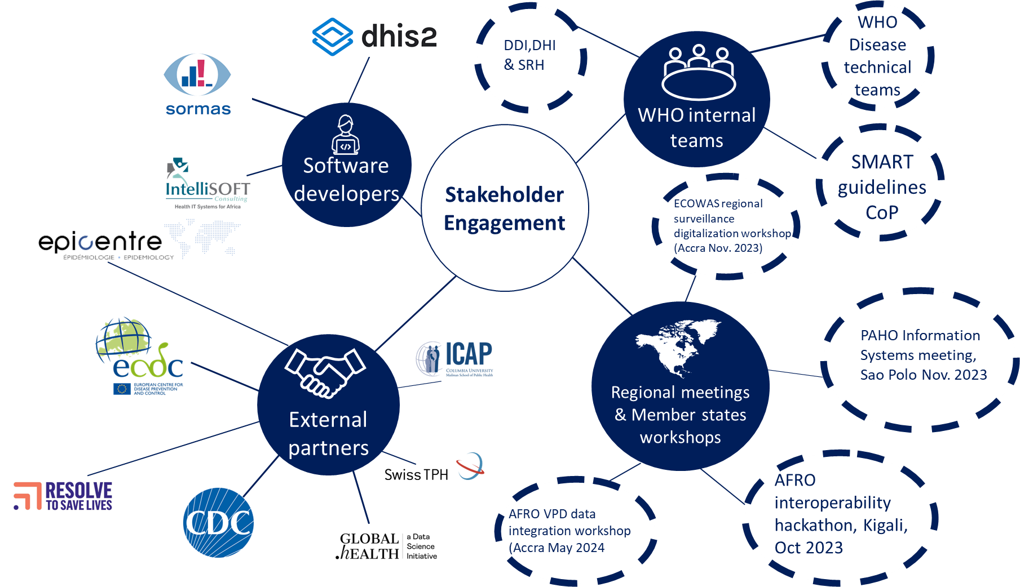

Une approche collaborative
Co-create
Implement
Invest
Advocate

Slide 15
Plan d’action
Project launch & communication
Horizon scan & gaps analysis
Data standards development
Country implementation
Sustain & amplification
Stakeholder mapping and engagement
Change management
Communication
Existing initiatives
Country case studies (gaps & challenges)
5 prioritized diseases: cholera, yellow fever, meningitis, measles, COVID-19
Using SMART guidelines approach
Workshop and/or Connecthatons
Implementation research
M&E
Case studies
Lessons learned
Investment case
Scale-up
Notes:
Before ending this presentation, I’d like to outline our way forwards with this project.
We plan to develop them by building on existing initiatives and adopting a user-centric approach
For now, we have prioritized 5 diseases for the development of these standards
And by next year, we plan to test the implementation of these standards at country level
This will help us capture lessons learned, refine our approach and inform investment case for eventual scale-up.
In conclusion, this initiative is not just about developing standards; it's about creating a sustainable and responsive surveillance system that can protect public health more effectively.
Thank you for your attention and support as we embark on this critical journey.

Slide 16
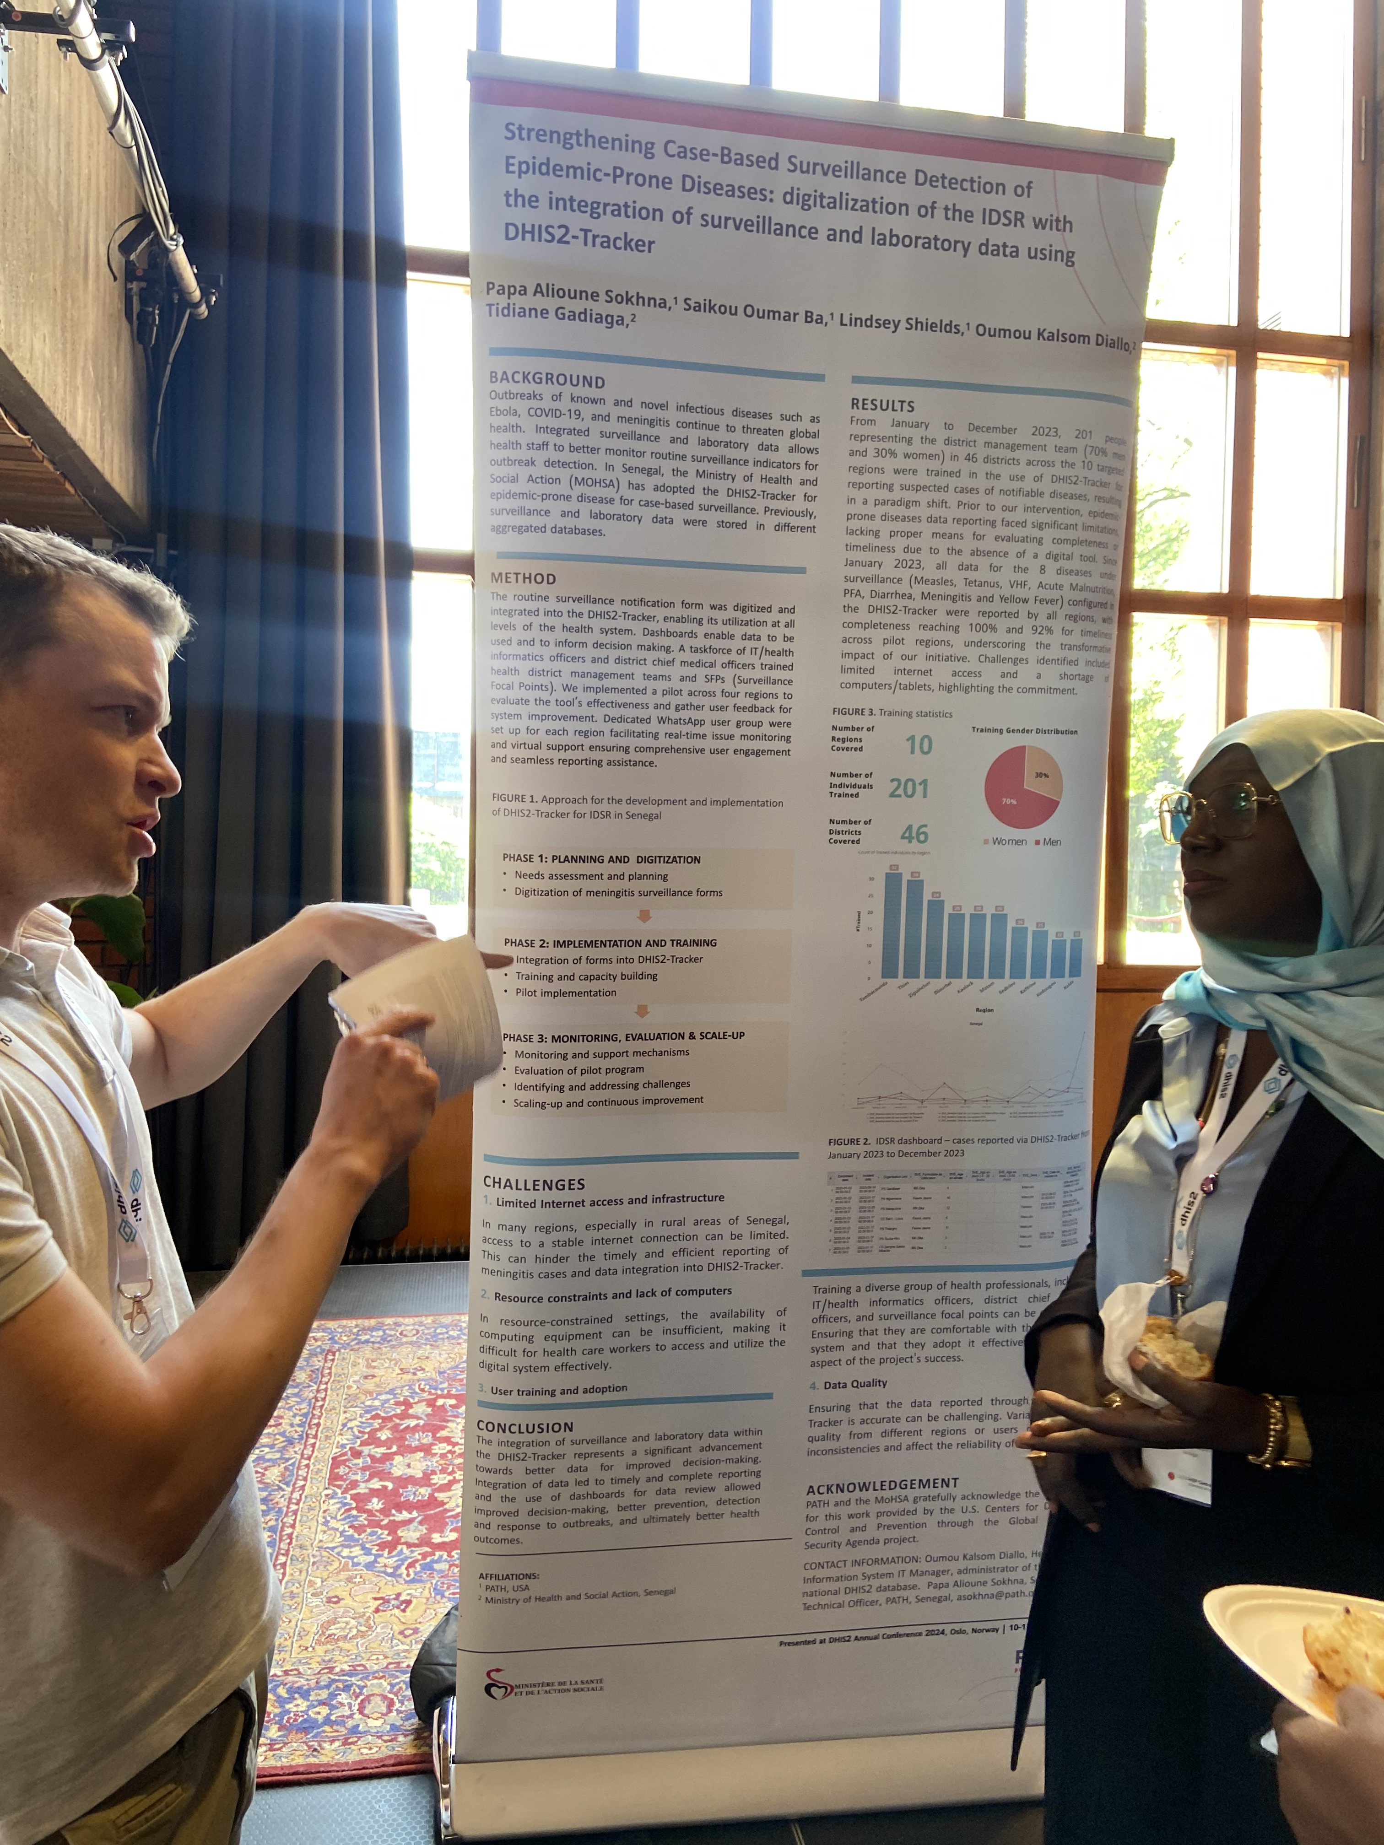
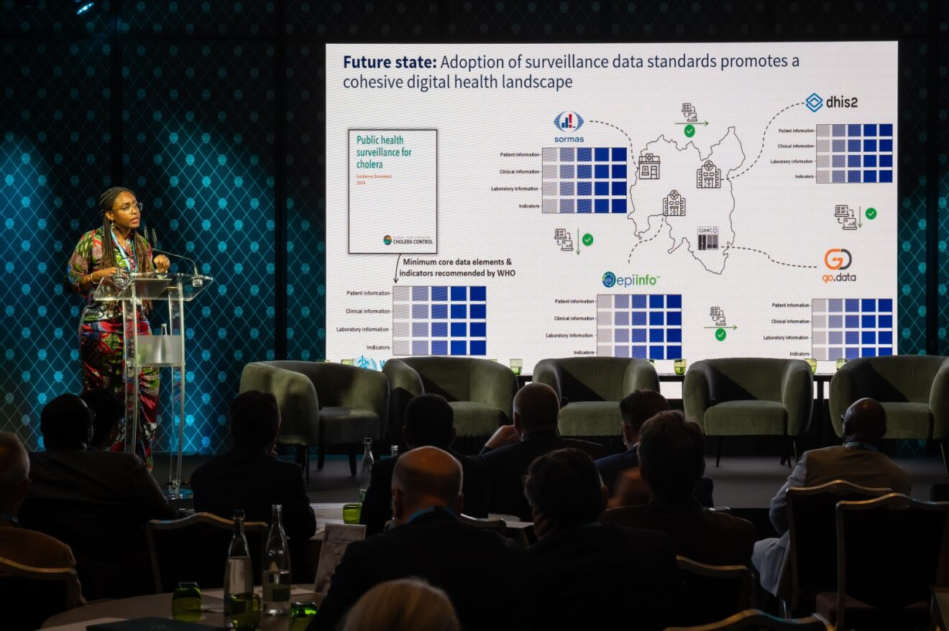
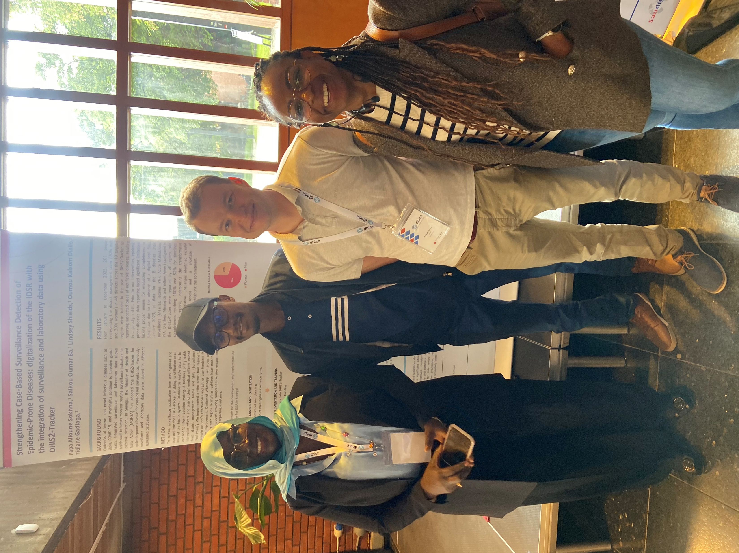
Thank you
For further information, please contact:
Patricia Ndumbi (ndumbip@who.int) – Project Lead
Schenckel Karl (schenkelk@who.int) – Unit head Strategy and Guidelines
Gérard Krause (krauseg@who.int) – Director Surveillance Systems

Slide 17
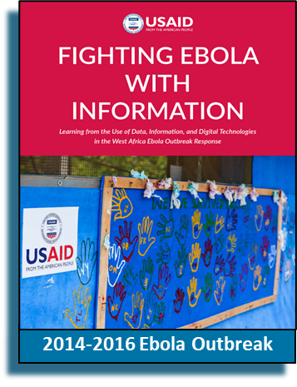

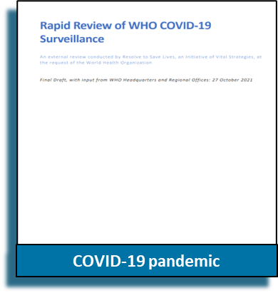

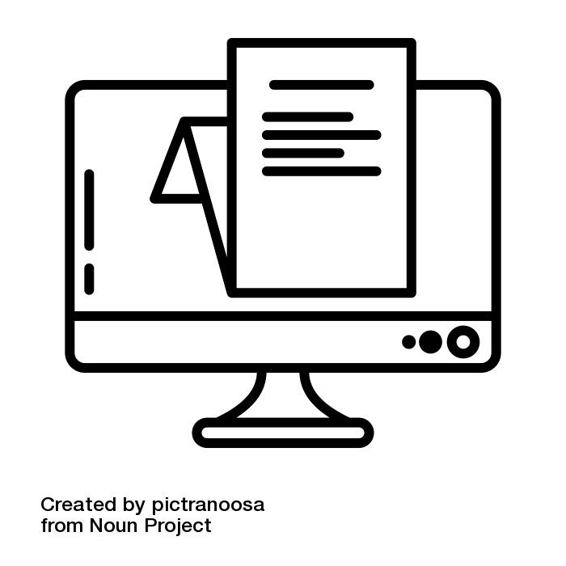
Leçons tirées des épidémies passées
Key challenges in the systematic collection, transmission and use of surveillance data:
Multiple forms, formats, and systems used to collect data
Burden and duplication of data collection efforts by health care workers
Inconsistencies in digital adoption of WHO surveillance guidelines
Notes:
Plusieurs obstacles dans la collecte et transmissions des donnees…
Utilisation de multiples formulaires, formats et systèmes pour collecter des données
Fardeau et duplication des efforts de collecte de données pour les travailleurs de la santé
Incohérences dans la façon dont les recommendations de l’OMS sont adoptée/représentées dans les système digiteaux

Slide 18
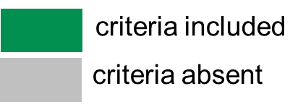
Data Standards development: Guidelines assessment
FOR INTERNAL USE ONLY!
COVID-19 guidelines include;
COVID-19 clinical management (2021)
COVID-19 therapeutics guidelines (2023)
COVID-19 public health surveillance(2022)
COVID-19 Diagnostics testing guidance(2020)
COVID-19 Outbreak Tool kit (2022)

Slide 19
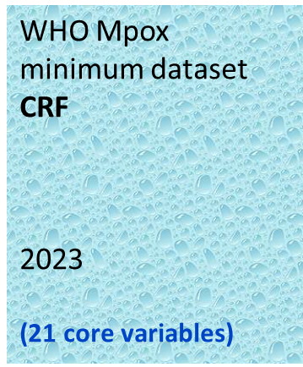

Representation of CRF core data elements in digital systems
WHO 2023 | GO.DATA |  | DHIS2 | SORMAS
Case Demographics 8 | 8 | 4 |  | 3 |  | 5
Medical History 3 | 3 | 4 |  | 2 |  | 2
Clinical Presentation 6 | 6 | 21 |  | 3 | 1 |  | 2
Exposure 3 | 3 | 5 |  | 1 | 1 |  | 1
Laboratory Information 1 | 1 | 7 |  | 1 |  | 1
 | Core data element included and similar to WHO 2023 guidance
 | Additional core data element added not included in WHO 2023 guidance
 | Core data element included in WHO 2023 guidance but not included in software tool

Slide 20

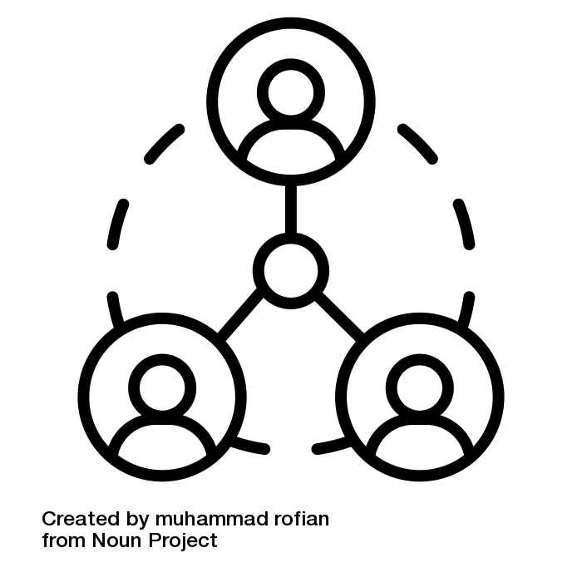
Key engagements (January to June 2024)
Stakeholder Engagement
+20 Member states
10 External groups
12 WHO HQ teams/dpt.
6 WHO Regional Offices
Presentations at events:
GTFCC conference (May)
CS Policy Forum (May)
DHIS2 conference (June)
Workshops and Webinars
4 workshop
Change Management (March)
RO webinar (May)
AFRO VPD Data integration (May)
Data standards retreat (June)
Theory of change
Engagement strategy
Communication plan

